Slide 1

Decision Modelling Report
Author - Swas Airee

Slide 2
Executive Summary
This decision model helps Coastal Nest Motel optimise pricing and overbooking strategies during peak season. Built in Excel, the model combines fixed and stochastic inputs to simulate bookings, cancellations, and profits, enabling both scenario and risk analysis.
The primary decision variable is Room Rate ($150 vs. $200). Findings show online bookings have the highest impact on profits, while cancellations pose the biggest risk.
Scenario results confirm the $200 rate consistently delivers higher profits, even under worst-case conditions, with up to 37.5% profit growth. Risk analysis supports the $200 strategy as low-risk and high-reward, provided cancellations are controlled.
The model equips the Sales Manager to make fast, data-driven decisions in uncertain conditions.

Slide 3
INTRODUCTION
Business Context Coastal Nest Motel is a boutique, Airbnb-style stay located on a busy beachside tourist route, preparing for peak season demand.
Problem Unpredictable bookings, walk-ins, and cancellations create uncertainty in managing room availability and revenue.
Solution A spreadsheet-based decision model using Excel enables pricing and overbooking decisions through scenario and risk analysis.
Goal To maximise daily profit and occupancy while maintaining customer satisfaction and operational efficiency.

Slide 4
INPUTS OVERVIEW
INPUT | VALUE | EXPLANATION
Room Rate (D1) | $150 / $200 | Price per room per night
Overbooking Buffer (D2) | 5 | Extra bookings accepted beyond capacity
Decision Variables
INPUT | VALUE | EXPLANATION
Number of Rooms | 50 | Total standard rooms available for booking
Housekeeping Cost/Room | $20 | Cost to clean and prepare each room
Cancellation Penalty | $30 | Paid per cancelled guest as compensation
Max Overbooking Limit | 10 | Max allowed bookings beyond actual capacity
Fixed Inputs
INPUT | VALUE | EXPLANATION
Online Bookings (S1) | 35 | Daily online customer bookings (random variation)
Cancellation Rate (S2) | 10% | Percentage of online bookings that cancel
Walk-In Demand (S3) | 5 | Guests arriving without a booking
Misc. Costs (S4) | $50 | Random daily costs (e.g., repairs, lost items)
Stochastic Inputs

Slide 5
CALCULATED OUTPUTS
The model calculates key metrics such as revenue, cost, and profit based on booking activity, cancellations, and demand. These outputs provide real-time insights into daily performance and occupancy levels.
Metric | Explanation
Bookings After Cancellation | Net online bookings after applying cancellation rate
Total Demand | Sum of bookings after cancellation + walk-ins
Rooms Booked | Total rooms filled (min of demand vs. room capacity + buffer)
Overbooked Guests | Guests exceeding room capacity – compensated if applicable
Total Revenue | Room Rate × Rooms Booked
Total Cost | Sum of housekeeping, misc. expenses, and compensation if any
Key Calculated Values
Output | Explanation
Total Daily Profit | Revenue – Total Cost
Sold-Out Status | Indicates if all available rooms (including buffer) filled
Final Output Metrics

Slide 6
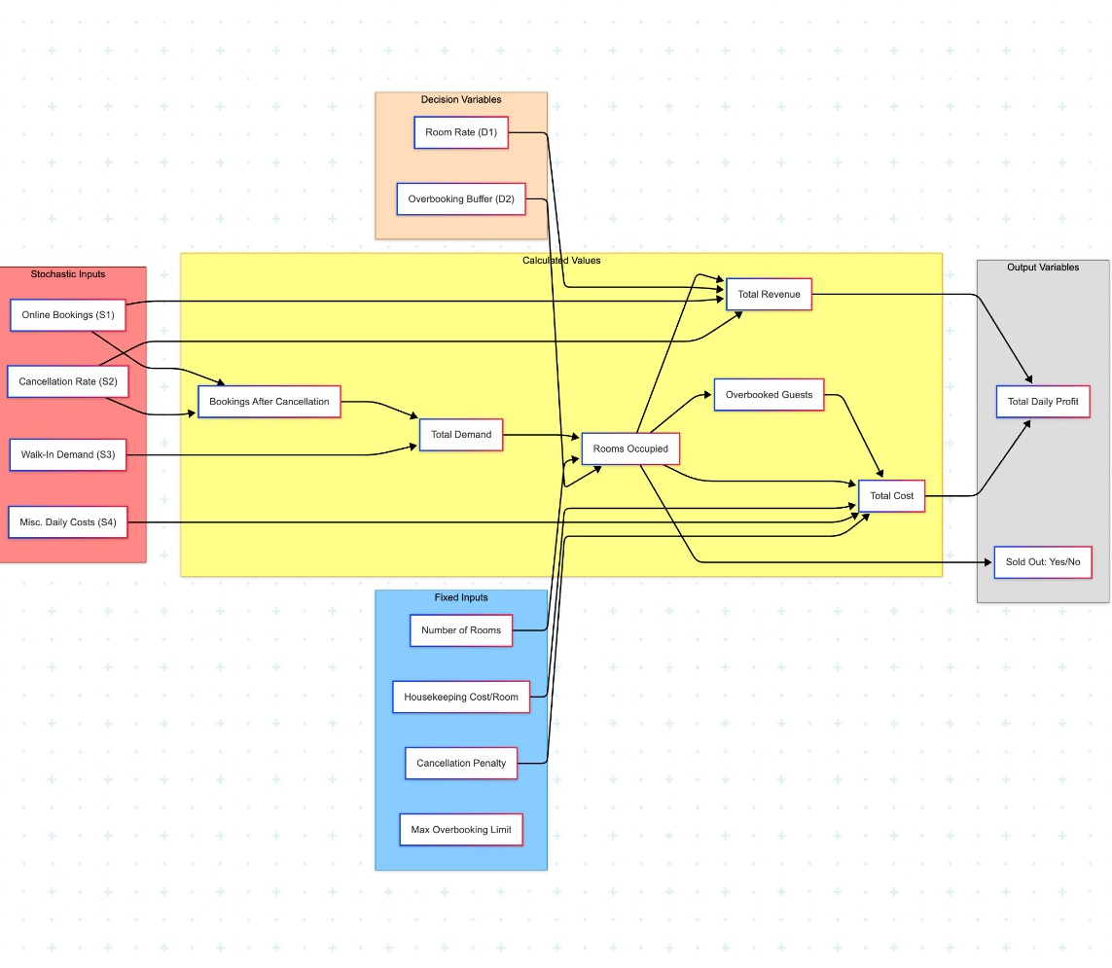
CONCEPTUAL MODEL & ASSUMPTIONS
Key Assumptions:
The model simulates daily operations for one room type only.
Online bookings, walk-ins, and cancellations drive demand variability.
Overbooking is allowed up to a fixed buffer (Max = 10 rooms).
Cancelled guests are compensated using a flat penalty rate.
Revenue is calculated from rooms booked; cost includes housekeeping, misc., and overbooking penalties.
All outputs (profit, sold-out status) are calculated per day.

Slide 7
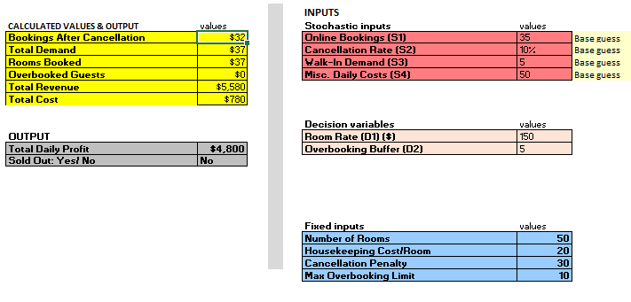
EXCEL DECISION MODEL OVERVIEW
This Excel-based model captures all critical decision inputs, including fixed values, stochastic variables, and decision levers (room rate, overbooking buffer). It uses built-in formulas to calculate daily revenue, cost, profit, and occupancy status, enabling dynamic scenario and risk analysis.
The layout is colour-coded for clarity:
Stochastic Inputs (Top-right)
Decision Variables (Mid-right)
Fixed Inputs (Bottom-right)
Calculated Metrics (Left)
Final Outputs (Bottom-left)

Slide 8
EXCEL DECISION MODEL OVERVIEW
This Excel-based model captures all critical decision inputs, including fixed values, stochastic variables, and decision levers (room rate, overbooking buffer). It uses built-in formulas to calculate daily revenue, cost, profit, and occupancy status, enabling dynamic scenario and risk analysis.
Stochastic Inputs (Top-right)
Decision Variables (Mid-right)
Fixed Inputs (Bottom-right)
Calculated Metrics (Left)
Final Outputs (Bottom-left)

Slide 9
SCENARIO ANALYSIS FRAMEWORK
Variable | Best | Base | Worst
Online Bookings @ $200 Room Rate | 50 | 30 | 0
Online Bookings @ $150 Room Rate | 55 | 35 | 0
Cancellation Rate (%) | 0% | 10% | 100%
Walk-In Demand | 10 | 5 | 0
Misc. Daily Costs ($) | 30 | 50 | 70
Purpose
To evaluate how key inputs—demand, cancellations, and costs—affect profit outcomes under different business conditions. Scenario analysis helps identify which decision strategies are most profitable and least risky.
Primary Decision Variable: Room Rate
Room Rate ($150 vs. $200) was selected as the primary decision variable for the following reasons:
Directly impacts revenue and profit, making it the most financially sensitive lever.
Easier to control in real operations compared to guest demand or cancellations.
Enables clearer comparison of profitability across demand levels while holding other inputs constant.
Simulation results showed room rate changes influence profit more than cost variations.

Slide 10
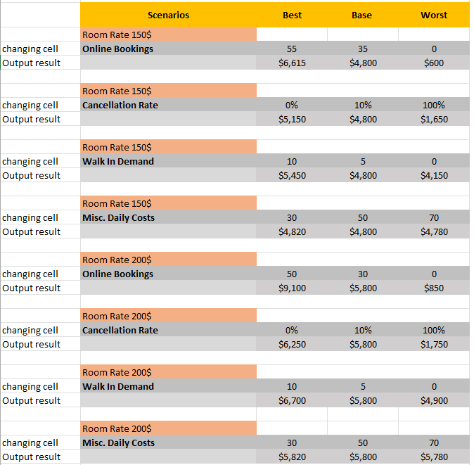
SENSITIVITY ANALYSIS OF STOCHASTIC INPUTS
Key Insights
Online Bookings are the most sensitive factor at both price points.
At $150: Profit ranges from $600 to $6,615 (↓87.5% to ↑38%).
At $200: Profit swings from $850 to $9,100 (↓85% to ↑57%).
Cancellation Rate shows high volatility.
At $150: $5,150 (0%) → $1,650 (100%)
At $200: $6,250 (0%) → $1,750 (100%)
Walk-In Demand adds moderate profit gain.
Difference of $1,300–$1,800 across both rates.
Misc. Daily Costs have minimal effect.
Only $20–$40 difference in profit even under cost extremes.
Conclusion: Profit is highly sensitive to online bookings and cancellations. Pricing at $200 provides greater resilience, but effective demand and cancellation management is crucial for sustained profitability.

Slide 11
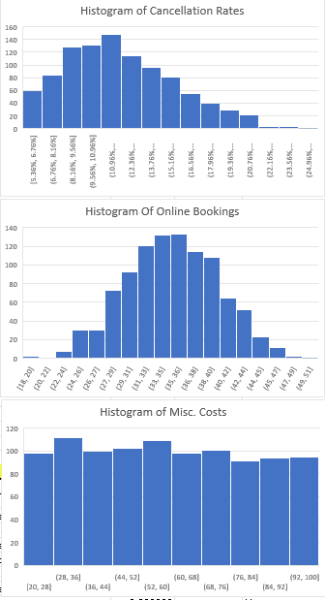
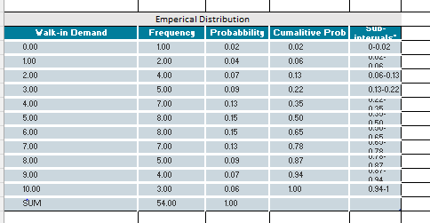
DISTRIBUTION JUSTIFICATION FOR STOCHASTIC INPUTS
OVERVIEW Each stochastic input was evaluated using descriptive statistics and histogram analysis from simulation data (n = 1000). The most suitable probability distribution was selected to reflect real-world variability and ensure robust stochastic modeling.
CANCELLATION RATE – BETA DISTRIBUTION (Α = 2, Β = 5)
Statistical Fit: Mean = 0.123, Skewness = +0.51, Bounded between 0 and 1
Histogram Insight: Right-skewed, concentrated near low values
Justification: The Beta distribution captures bounded proportion data with right asymmetry, matching cancellation behavior in peak season.
ONLINE BOOKINGS – NORMAL DISTRIBUTION
Statistical Fit: Mean = 34.77, Skewness ≈ 0, Kurtosis = −0.26
Histogram Insight: Symmetric bell curve centered on mean
Justification: Booking data shows minimal skew and consistent dispersion, making the Normal distribution ideal for modeling daily booking fluctuations.
MISCELLANEOUS DAILY COSTS – UNIFORM DISTRIBUTION
Statistical Fit: Range = $20–$100, Skewness ≈ 0
Histogram Insight: Flat distribution with equal frequency across intervals
Justification: Cost values are uniformly distributed with no dominant mode, validating the use of a Uniform distribution for random, bounded costs.
WALK-IN DEMAND – EMPIRICAL DISTRIBUTION
Observed Data: Demand ranges from 0–10 guests; highest frequency at 5–6
Empirical Profile: Probability estimates derived from real simulation frequencies
Justification: No parametric shape fits. An Empirical distribution allows realistic modeling of discrete, unpredictable arrivals.

Slide 12
SIMULATION RESULTS & CONVERGENCE ANALYSIS
Metric | Room Rate $150 | Room Rate $200
Mean Profit | $4,742 | $5,834
Standard Deviation | $705 | $926
Min / Max Profit | $2,766 – $6,632 | $2,841 – $9,046
90th Percentile | $5,659 | $7,017
10th Percentile | $3,825 | $4,671
IQR (Spread of Core 50%) | $981 | $1,228
Insights from Output Distributions
Room Rate $200 consistently outperforms $150, with a higher mean and wider upper profit potential.
Despite slightly greater variability, the $200 rate shows better profit stability in the 90% range.
$150 offers a narrower band, lower profit ceiling, and more probability of moderate performance.

Slide 13
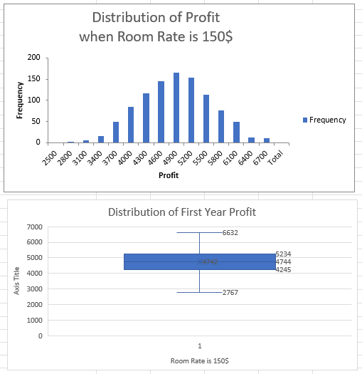
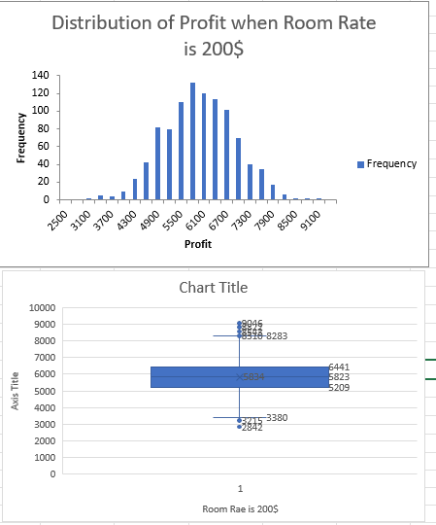
SIMULATION RESULTS – PROFIT DISTRIBUTION COMPARISON
KEY INSIGHTS
Room Rate $200 delivers higher average profit and broader upper-end potential.
Greater standard deviation reflects slightly higher risk, but reward outweighs.
$150 shows tighter clustering around the mean with limited upside.
METRIC | ROOM RATE $150 | ROOM RATE $200
Mean Profit | $4,742 | $5,834
Standard Deviation | $705 | $926
Min / Max Profit | $2,766 – $6,632 | $2,841 – $9,046
90th Percentile | $5,659 | $7,017
10th Percentile | $3,825 | $4,671
IQR (Q1–Q3) | $981 | $1,228

Slide 14
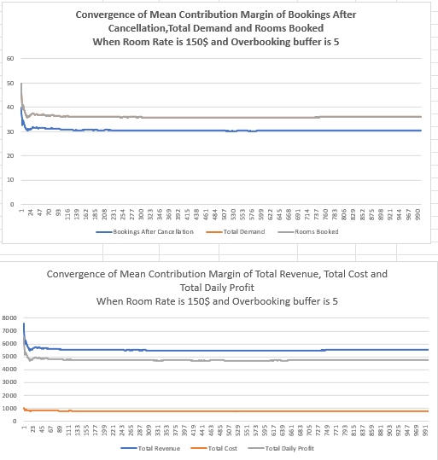
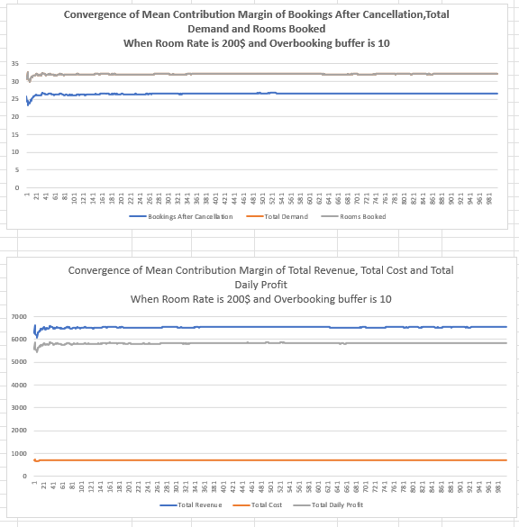
CONVERGENCE ANALYSIS – MODEL RELIABILITY
Purpose To assess if the simulation results are stable and not sensitive to run order or randomness.
Insights
For both pricing strategies, mean values stabilize within the first ~200 iterations.
No upward/downward drift observed across 1000 runs.
Profit, cost, and demand variables converge smoothly, confirming model robustness.
Conclusion The simulation model is statistically sound and reliable, with converging outputs and minimal volatility, strengthening confidence in pricing strategy recommendations.

Slide 15
RISK ANALYSIS – PROFIT BAND DISTRIBUTION & SENSITIVITY
Key Insights
Room Rate $150
81.3% of profits fall between $3,500–$5,500, indicating moderate returns.
Only 0.5% of cases exceeded $6,500 → limited upside.
Profitability highly dependent on demand exceeding 35–42 guests.
Room Rate $200
93.3% of profits exceeded $4,500, showing higher and more consistent profitability.
23% of outcomes surpassed $6,500 even without full occupancy.
Sharp performance drop below 25 guests (as low as $2,841), but rare (0.7%).
Conclusion
$200 strategy offers a low-risk, high-reward profile with wider upside potential.
Demand sensitivity remains key for both, but $200 pricing shows greater resilience and profitability when managed effectively.
Strong case for adopting $200 Room Rate with demand forecasting and cancellation controls in place.
Profit Band ($) | $150 Pricing | $200 Pricing
$2,500 – $3,500 | 3.9% | 0.7%
$3,500 – $4,500 | 33.5% | 6.0%
$4,500 – $5,500 | 47.8% | 29.1%
$5,500 – $6,500 | 14.3% | 41.2%
Over $6,500 | 0.5% | 23.0%

Slide 16
FINAL RECOMMENDATIONS
1. Adopt $200 Room Rate as Standard
Yields higher average profit ($5,834 vs. $4,742)
Stronger performance in 93.3% of simulations
23% chance of earning over $6,500 even without full occupancy
2. Maintain Overbooking Buffer at 5 Rooms
Balances risk of cancellation without compromising guest satisfaction
Avoids frequent compensation events while maximizing occupancy
3. Actively Monitor Booking Demand
Demand is the primary driver of profit volatility
Use historical data and real-time tracking to forecast demand more accurately
4. Mitigate Cancellation Risk
Introduce deposit policies or limited refund terms
Especially important at higher price points to secure revenue stability
5. Use Simulation Model for Ongoing Decision Support
Adapt to seasonal changes and emerging trends
Re-run model quarterly to reflect updated inputs and assumptions

Slide 17
FINAL CONCLUSION & STRATEGIC WRAP-UP
KEY TAKEAWAYS
The $200 room rate consistently outperformed the $150 strategy, offering a superior balance of profitability and risk.
Demand variability and cancellation rates emerged as critical factors influencing outcomes.
The model demonstrated strong convergence and reliability, validating its use for ongoing strategic decision-making.
Scenario and risk analysis enabled clear comparison under uncertain market conditions.
STRATEGIC OUTLOOK By integrating this model into their pricing and booking strategy, the motel can make confident, adaptive decisions that respond to customer behaviour and market shifts — ensuring both financial sustainability and guest satisfaction.

Slide 18
REFERENCES
Arunn Thevapalan. (2024, May 2). Monte Carlo Simulation in Excel: A Complete Guide. Datacamp.com; DataCamp. https://www.datacamp.com/tutorial/monte-carlo-simulation-in-excel
Iván Palomares Carrascosa. (2025, March 25). A Complete Guide to Understanding Probability Distributions. Statology. https://www.statology.org/a-complete-guide-to-understanding-probability-distributions/
List of Excel Formulas and Functions. (n.d.). Excel. https://excelx.com/formulas-functions/
Modeling. (n.d.). Stratechi. https://www.stratechi.com/creating-an-analytic-model/

